Slide 1

Intercultural Cooperation in Genetics
Population Genetics Research in Western Balkan Countries Through the Work of Prof. Dr. Damir Marjanović
Scientific Overview and Regional Cooperation Analysis | 2026

Slide 2

Introduction to the Scientific Context
Genetics as a Bridge and Scientific Link Among the Peoples of the Western Balkans

Slide 3
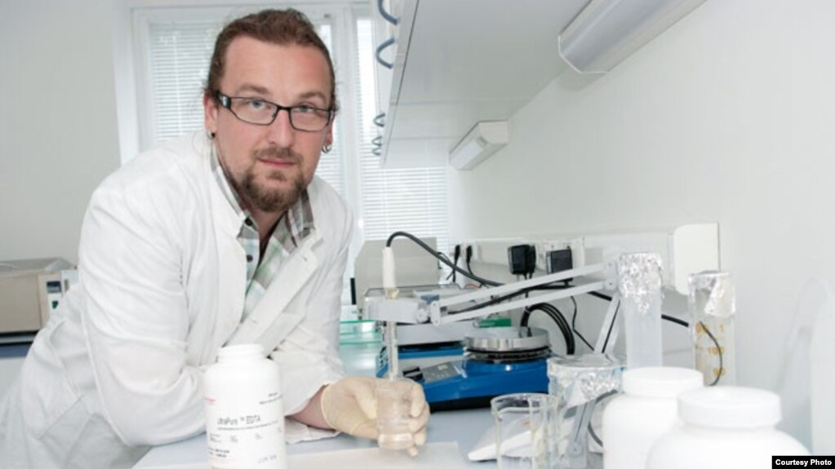
Prof. dr. Damir Marjanović
Pioneer of Population and Forensic Genetics
Prof. Dr. Damir Marjanović: one of the leading geneticist in the SEE region, full professor, and scientific advisor
Institute for Anthropological Research in Zagreb and universities in Sarajevo
Over two decades of research on the genetic diversity of the Balkan population
Key contribution to identification of war victims (ICMP)
Establishment of a regional scientific network

Slide 4






Pillars of Regional Cooperation
Joint Projects:
Collaborative scientific studies by institutes from Sarajevo, Zagreb, Belgrade, Podgorica, and Skopje
Data Standardization:
Harmonization of DNA databases and methodologies for population and forensic research
Young Researchers:
Education and academic student exchanges through regional Master's and PhD programs

Slide 5


Western Balkans Context
Ethnonational Mythologies:
Post-war region burdened by political and pseudoscientific attempts to prove "distinct ethnic origin"
Scientific Response & Empiricism:
Molecular anthropology provides exact, objective facts

Slide 6


Fundamentals of Population Genetics
Y-Chromosome & mtDNA Analysis:
Tracing prehistoric and historical migrations via patrilineal and matrilineal lines
Disproving Boundaries:
Modern political and ethnic borders do not correspond to the genetic structure
Centuries of Admixture:
Balkan genetic profile is the result of thousands of years of human migration and mixing

Slide 7
Regional Genetic (Dis)Continuity
>70%
High Degree of Relatedness Across Borders
Paleolithic and Neolithic heritage among populations of BiH, Croatia, Serbia, Montenegro, and North Macedonia originates from the same sources
Common Genetic Pool

Slide 8
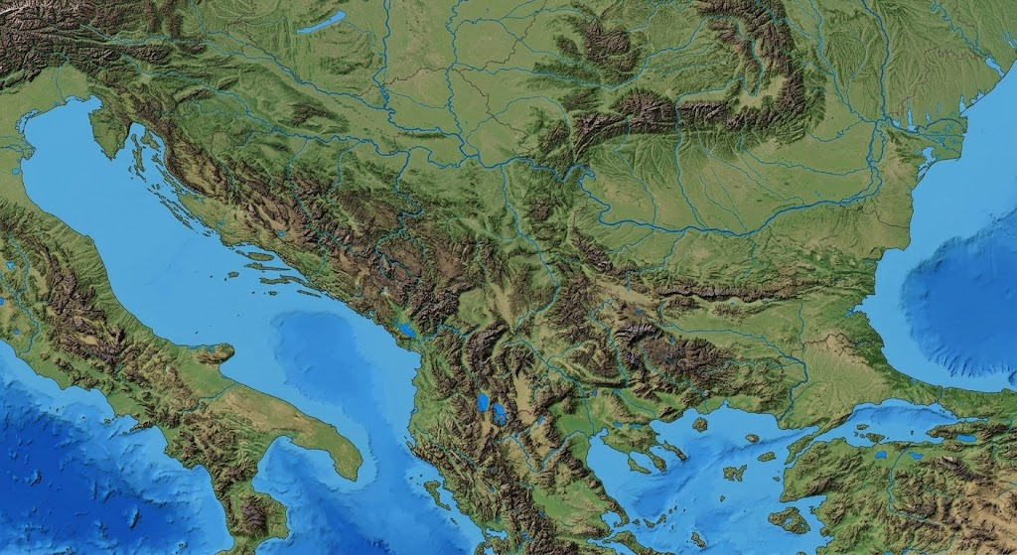
Debunking Genetic Myths
No "Ethnic Genomes": In biology, there is no "Bosniak", "Croat", or "Serb" gene
High Intra-group Variability: Genetic variability within a single ethnic group is greater than between different ethnic groups in the region
Science Over Ideology: Empirical evidence refutes division narratives

Slide 9
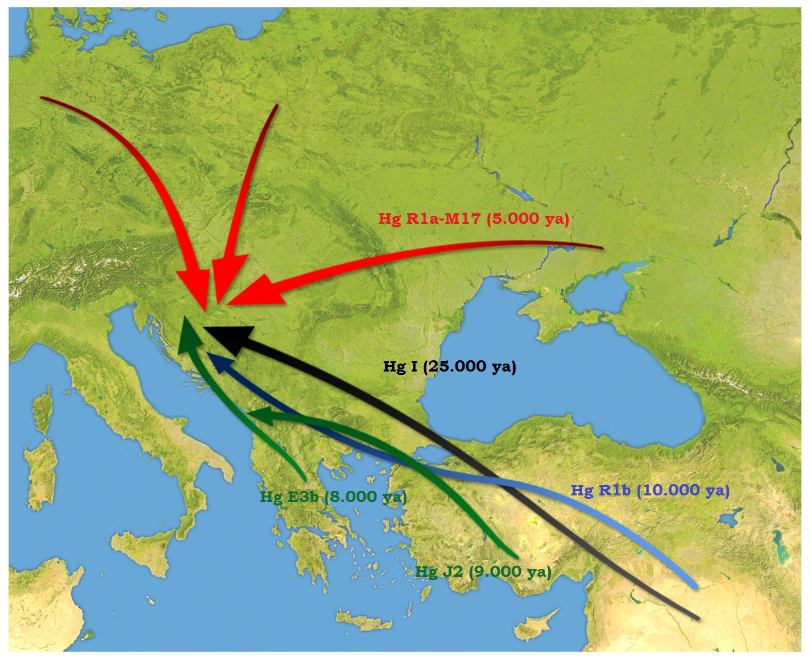
Distribucija Y-Haplogrupa
Distribution of Y-Haplogroups
Haplogroup I2a (45%): Most prevalent in BiH and Croatia (Paleolithic continuity)
Haplogroup E-V13 (20%): Shared Balkan Neolithic heritage
Haplogroup R1a (15%): Slavic migration heritage
Haplogroup R1b: West European lineage
Continuity: Data confirms unbroken lineages regardless of modern ethnic affiliation

Slide 10
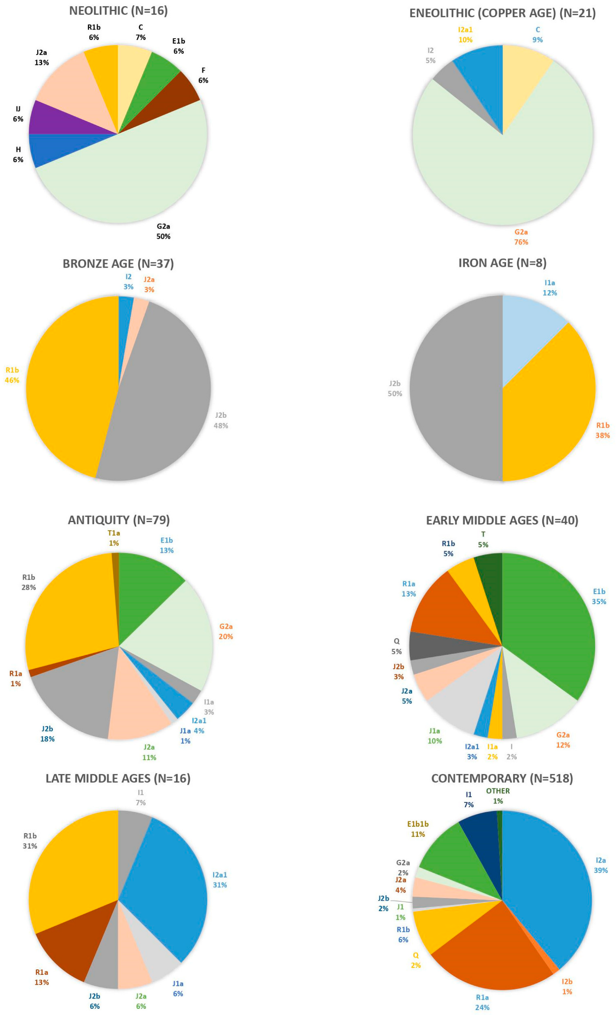
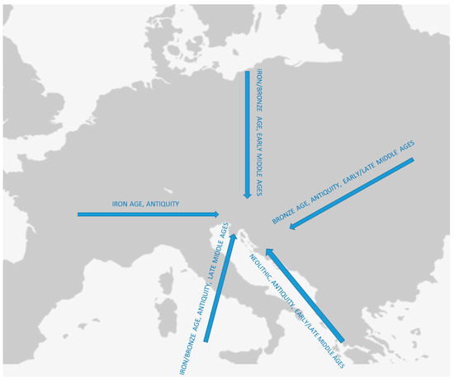
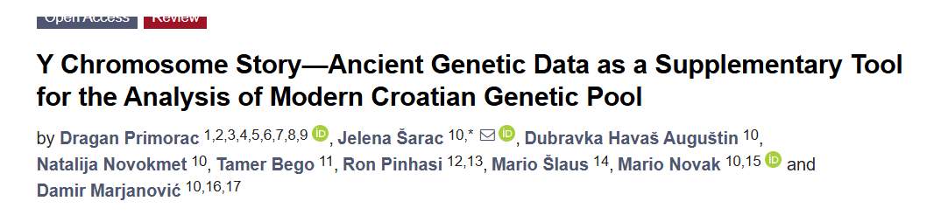

Slide 11
Overview of Scientific Papers
Godina | Naslov Rada | Časopis | Ključni Nalaz
2005. | The Peopling of Modern Bosnia and Herzegovina | Annals of Human Genetics | Otkrivena visoka frekvencija I2a haplogrupa i paleolitski kontinuitet.
2014. | Standing at the Gateway to Europe (PLOS ONE) | PLOS ONE | Potvrđen genetički kontinuitet Zapadnog Balkana i Bliskog Istoka.
2018. | An ethnic genetics - case study of B&H | GenApp | Naučna dekonstrukcija etničkih mitova o porijeklu.
2022. | Croatian genetic heritage: Y-chromosome story | Frontiers / FDMZ | Genetička bliskost hrvatske i bh. populacije.

Slide 12
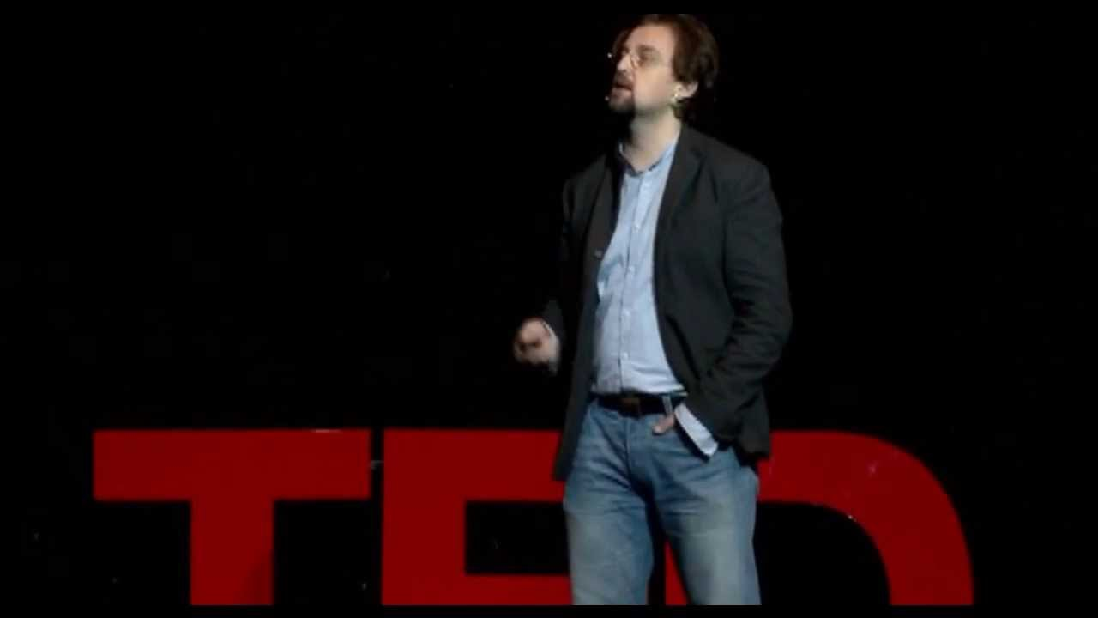
Science and Society
"Genetics teaches us that our differences are superficial and recent, while what connects us has been deeply engraved in our DNA for thousands of years."
— Prof. dr. Damir Marjanović

Slide 13
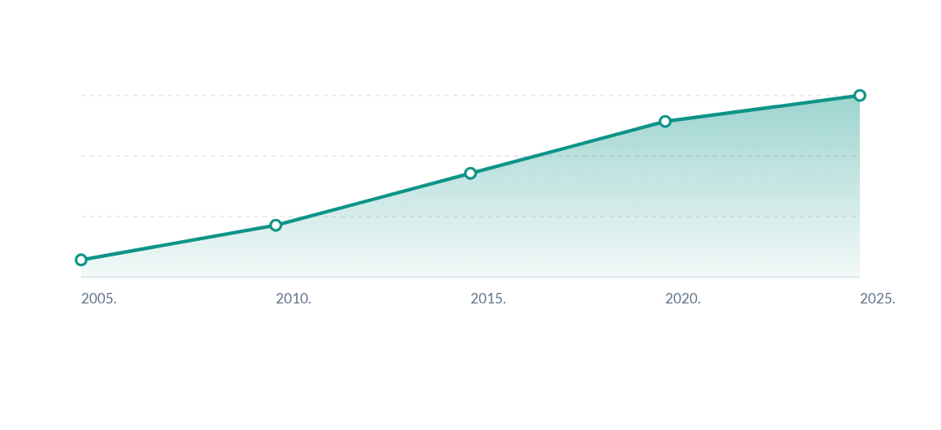
Growth of Regional Publications
Steady increase in co-authored publications by geneticists from BiH, Croatia, Serbia, and Montenegro
Growth observed in top-tier indexed international journals over the last two decades

Slide 14
Recommendations for Cooperation
Sustainable Funding: Joint applications to EU funds (Horizon Europe, IPA) for regional consortia
Infrastructural Connectivity: Shared platforms for storing and analyzing genomic data
Bioethical Harmonization: Aligning legal and ethical frameworks for genetic research
Public Education: Continuous dialogue between scientists and media to combat pseudoscience

Slide 15


Knowledge That Connects:
Genetics demonstrates that scientific collaboration transcends political boundaries

Slide 16

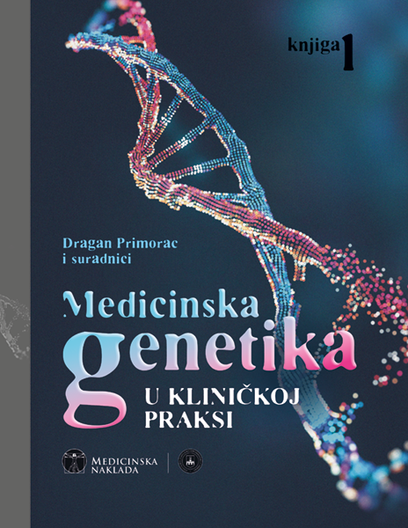

Slide 17
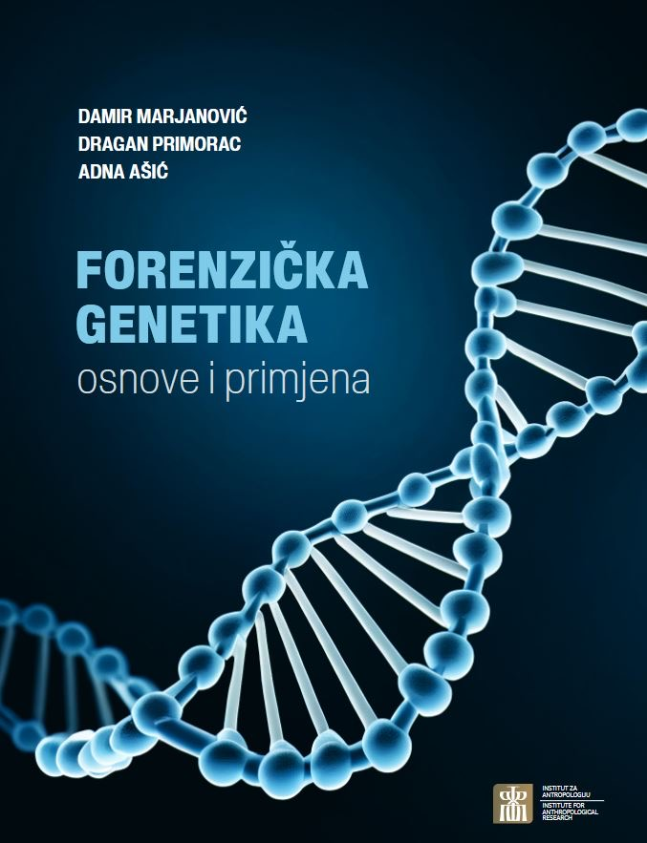
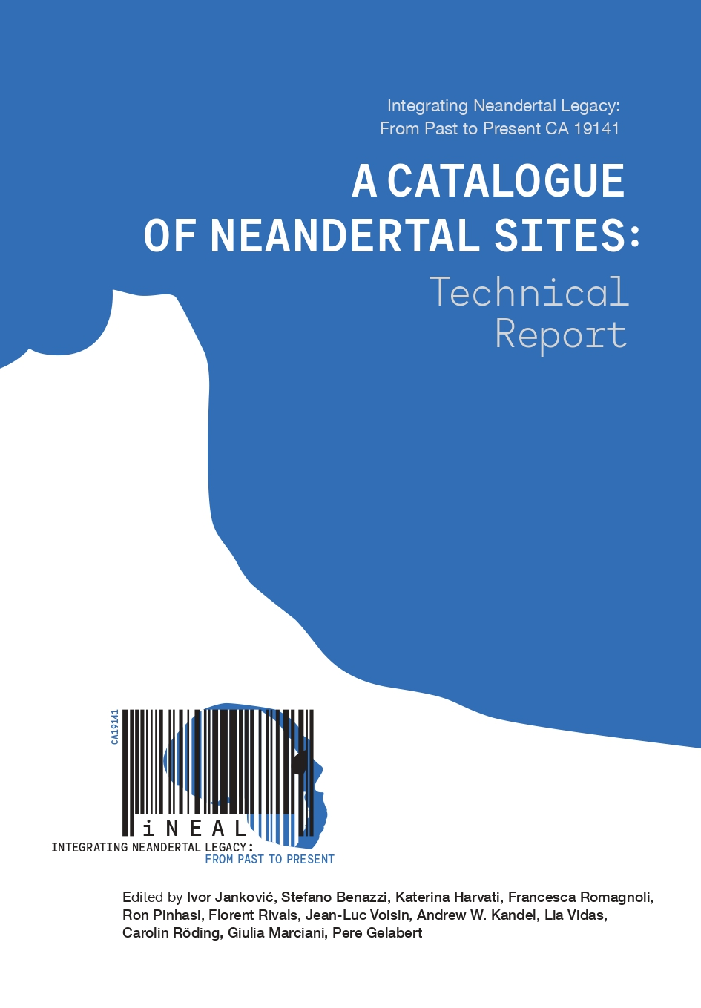

Slide 18
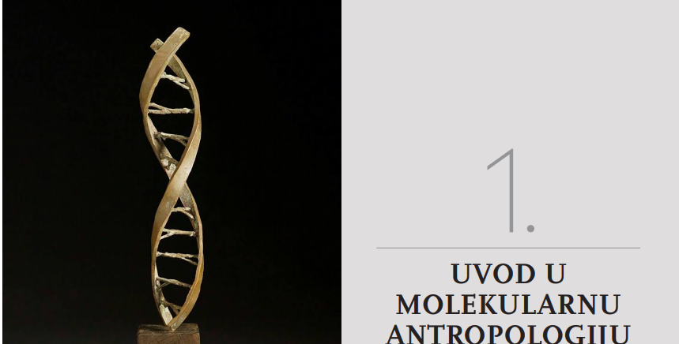

Slide 19
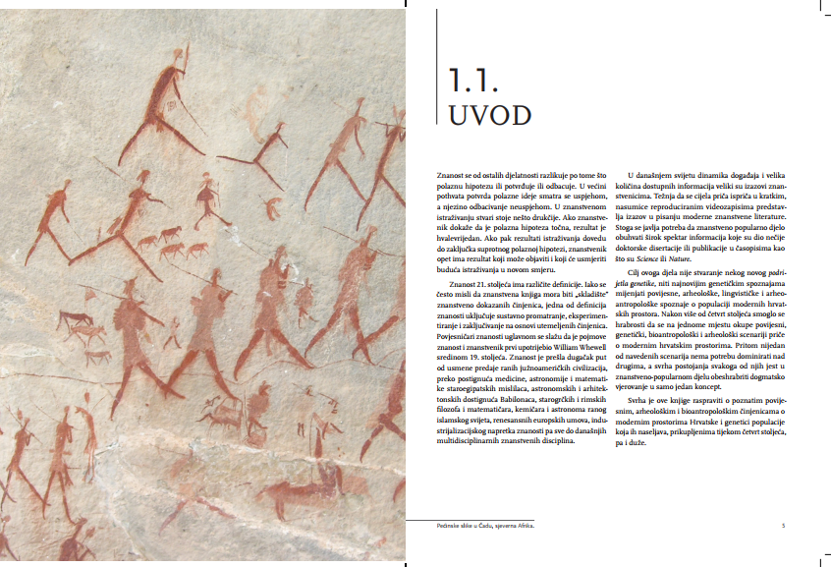

Slide 20
Reference i Literatura
Izvor / Autor | Naslov Radovi / Medij | Godina / Detalji
Marjanović D. et al. | The Peopling of Modern Bosnia and Herzegovina: Y-chromosome perspective | Ann. Hum. Genet. 69(6): 757-763 (2005)
Kovacevic L., Marjanovic D. et al. | Standing at the Gateway to Europe: Genetic Structure of Western Balkan Populations | PLOS ONE 9(8): e105090 (2014)
Marjanović D., Primorac D. | Forenzična genetika: teorija i primjena (Knjiga) | Sarajevo / Zagreb (2013)
Škaro V., Marjanović D. et al. | Croatian genetic heritage: an updated Y-chromosome story | Frontiers / FDMZ Repozitorij (2022)
Marjanović D. | An ethnic genetics – case study of B&H: facts, fallacies and myths | GenApp Journal 1(1) (2018)
TEDx Talk (Video) | Genetic comparison of the Balkan nations - Prof. Dr. Damir Marjanović | TEDxUniversityofSarajevo (2013)

Slide 21



